Slide 1

Huffman Codes
Group 15
2020/05/13
LOGO

Slide 2
THE MAIN CONTENTS
01
Introduction
02
Data Structure and Algorithm Specification
03
Analysis and Comments
04
Testing Results
LOGO

Slide 3
1
第
部分
Introduction

Slide 4
01
Introduction
Problem Description
The input format in this project is including the following things A integer n, which means the number of characters. n characters and their frequency in pairs. A integer m, which means the number of hand-in answers from students. m groups of hand-in answers from students, each contains n pairs of character and its Huﬀman code.
Input format
We will check whether the hand-in answer is correct or not and output a "Yes" or "No" to show the result of our program.
Output format
LOGO

Slide 5
2
第
部分
Data Structure and Algorithm Specification

Slide 6
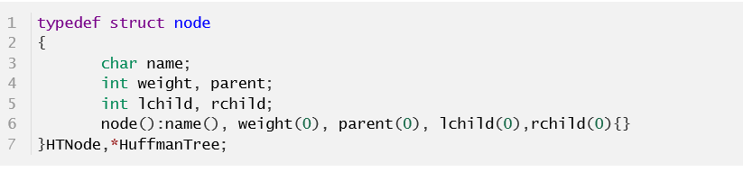
02
Data Structure and Algorithm
Huﬀman tree
Huﬀman tree is a binary preﬁx tree which store the characters in its leaf nodes. The Huﬀman code of a character is corresponding string on the Huﬀman tree of the data
Greedy Algorithm
Greedy algorithm works in optimizing problems, it choose the choice that can get most beneﬁts. But this algorithm works if and only if the local optimum is equal to the global optimum
LOGO

Slide 7
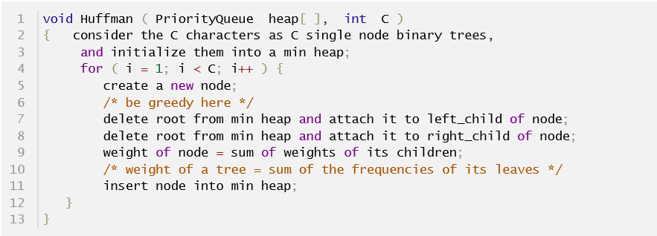
02
Data Structure and Algorithm
Min Heap
Min heap is a special tree-based data structure that the parent node is less than its non-empty children, but the siblings doesn't have any special relations. It can help us ﬁnd the highest priority node.
LOGO

Slide 8
02
Data Structure and Algorithm
pseudo-code of the whole program
LOGO

Slide 9
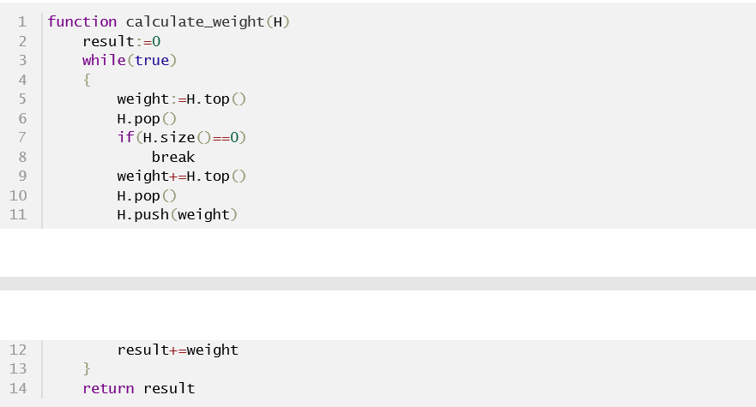
02
Data Structure and Algorithm
The most important two functions 1
Function 1:
calculate weight
LOGO

Slide 10
02
Data Structure and Algorithm
The most important two functions 2
Function 2:
check preﬁx
LOGO

Slide 11
3
第
部分
Analysis and Comments

Slide 12
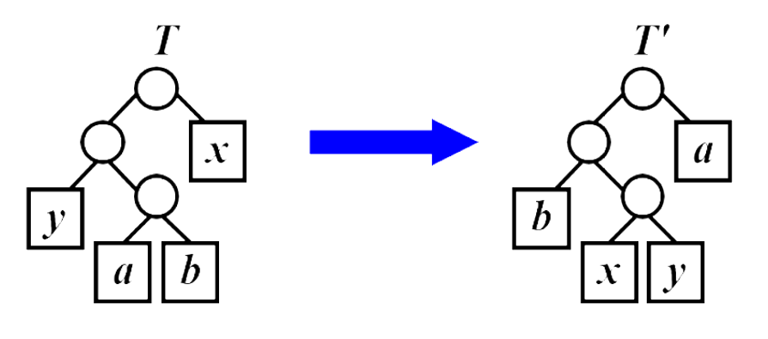
03
Analysis and Comments
The Greedy choice property
【Lemma】Let C be an alphabet in which each character c in C has the frequency c.freq. Let x and y be two characters in C having the lowest frequencies. Then there must exist an optimal preﬁx code for C in which the codewords for x and y have the same length and diﬀer only in the last bit.
Let C be a given alphabet with frequency c.freq deﬁned for each character c in C. Let x and y be 2 characters in C with minimum frequency. . Let C' be the alphabet C with a new character z replacing x and y, and z.freq = x.freq + y.freq. Let T' be any tree representing an optimal preﬁx code for the alphabet C'. Then the tree T, obtained from T' by replacing the leaf node for z with an internal node having x and y as children, represents an optimal preﬁx code for the alphabet C.
The optimal substructure property
LOGO

Slide 13
03
Analysis and Comments
Analysis of Min Heap
The time complexity of the min-heap operation cost most in out program, we have serveral operations in the program
Build min-heap: It is O(N) obviously to build a min heap because each insert cost O(logN)
Calculate the total weight: In the while loop, each time we pop 2 elements from the top of the heap(delete min) and insert 1 element into the heap. Delete min from heap and insert into heap both need O(logN) each time, so each time we need O(3logN+c) time. And we need do the loop N times to calculate the total weight of the Huﬀman tree, so the time complexity is O(NlogN) .
The space complexity of the min-heap is obviously O(N)
LOGO

Slide 14
03
Analysis and Comments
Analysis of algorithm complexity
Time complexity: The whole program contains several parts:
Read in the data:
It needs O(2N+MN)=O(MN) time complexity
Heap Operations:
It needs O(NlogN) according to 4.1
Check each group of answer:
It has m rounds and each round need O(N²) because if the preﬁx checking according to 4.2, so it needs O(MN²) in total
All in all : the time complexity is O(MN²)
Space complexity: The whole program contains several parts:
Build the heap: O(N)
Store the map from character to Huﬀman code: O(N)
Store the result of Yes and No to output them together ﬁnally: O(M)
So the time complexity is : O(M+N)
LOGO

Slide 15
4
第
部分
Testing Results

Slide 16
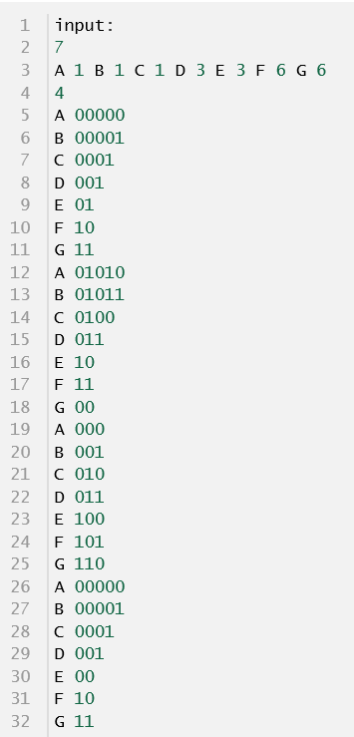
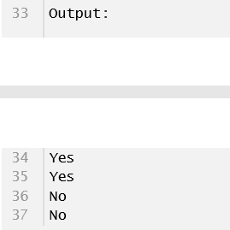
04
Testing Results
Test 1: Sample Data
LOGO

Slide 17
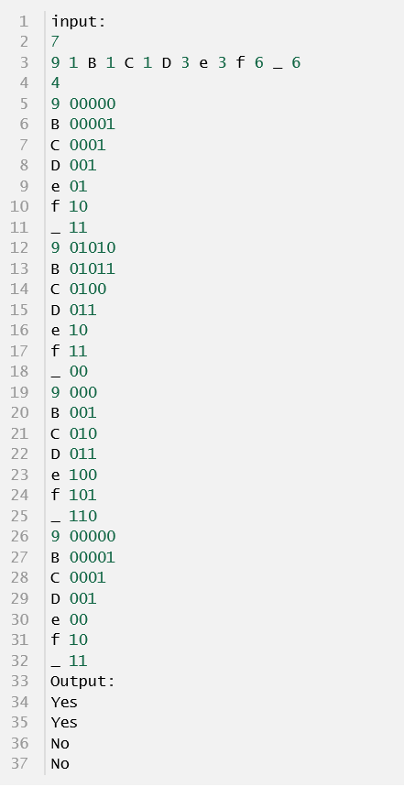
04
Testing Results
Test 2: Have characters of digit, '_' and letters
LOGO

Slide 18
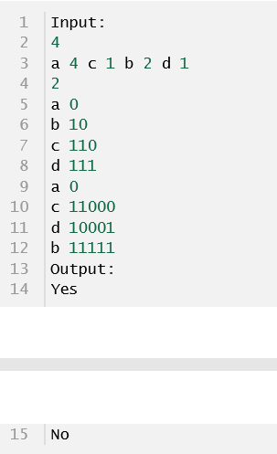

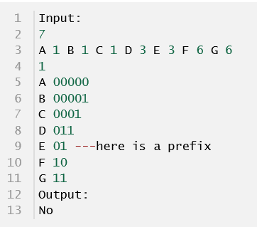
04
Testing Results
Test 3: Have some not optimum condition
Test 4: Have some code be preﬁx
LOGO

Slide 19
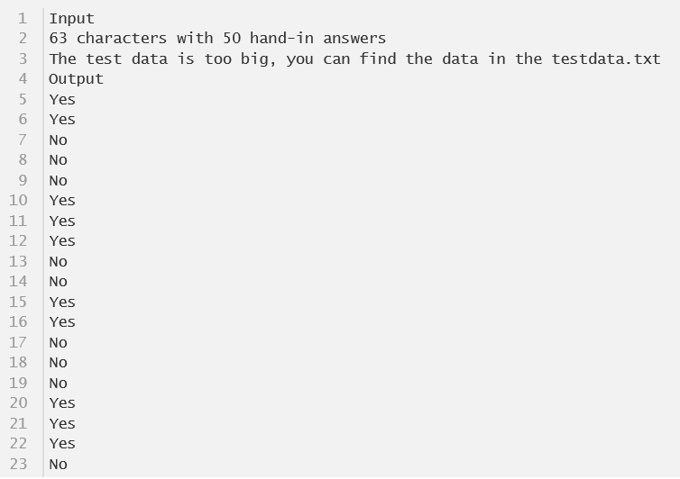
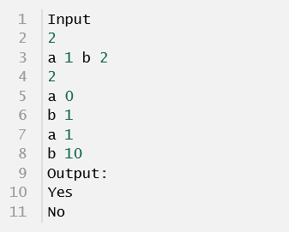
04
Testing Results
Test 5: A smallest size of test data.
Test 6: A largest size of test data
……
LOGO

Slide 20
谢谢您的观看与聆听
Group 15
2020/05/13
LOGO

